Slide 1
Cafe and Food Truck Business
Marketing Budget
Notes:
Marketing budget, concerns and issues.

Slide 2
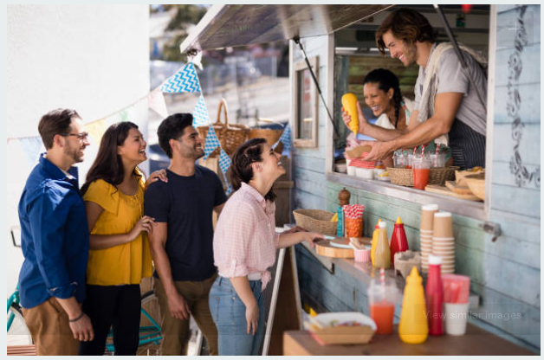
Introduction
Marketing budget is the estimated costs required to advance a business' items or administrations.
Marketing budget cater for promoting interchanges like site improvement, publicizing, and advertising, just as the expenses of utilizing promoting staff and using office space.
Notes:
Marketing budget cater for promotions, publicizing and advertising of business and business brands.

Slide 3
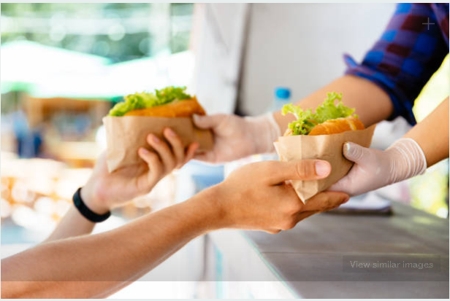
Concerns for Cafe and Food Truck Marketing Budget
The cafe and food truck business will:
- concentrate on the earlier year's arrangement and overlooking potential new deals, objectives and openings.
keep away from excessive spending and expenses effectively.
target brand improvement, content creation, digital media, Email programs/E-pamphlets, Events, Graphic plan, etc.
Notes:
The concerns for the food truck business include grabbing of new deals that can open job opportunities, minimise superfluous expenses and advertise the various brands.

Slide 4
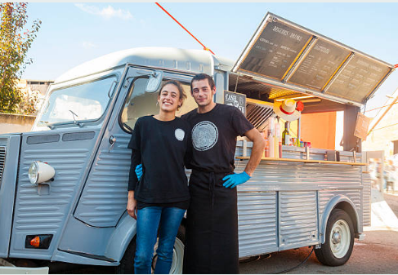
Possible Issues and their Solutions
Poor Organization of the marketing budget (Truong, 2019). The management will strive to align the showcasing objectives with the vision at that point organize the costs expected to accomplish the objective goals.
Incorrect data used to predict the possible outcome of any business undertaking (Truong, 2019). The management will ensure benchmark execution of each procedure when propelling budgeting.
Notes:
The management will ensure the drawing of marketing budget perfect, and the date used to predict positive outcome of the funded activity is correct.

Slide 5
Conti...
Miscommunication between departments of the business (Camilleri, 2018). The management will prevent such poor communication between departments by calming any existing pressure between them and encourage marketing team to convey their endeavors as far as cash contributed and benefitted.
Notes:
Disunity between and among departments should be avoided so that marketing of the business and business brands is successfully.

Slide 6
Conclusion
The cafe and food truck business will cross-examine the outcome of every business undertaking before they allocate some money for it.
The marketing budget prioritizes on such concerns as brand positioning, advertisement on social media platforms, promotions and production of pamphlets and billboards.
The management will harmoniously coordinate different stakeholders of the business to make marketing .effectiveness
Notes:
An effective marketing budget is that which funds activities which are earn the organisation some benefits.

Slide 7
References
Camilleri, M. A. (2018). Integrated marketing communications. In Travel marketing, tourism economics and the airline product(pp. 85-103). Springer, Cham.
Mullin, R. (2018). Promotional marketing. Routledge.
Truong, L. (2019). CRITICAL FACTORS BEHIND SUCCESS AND FAILURE OF SMALL BUSINESS: A Study in Food Truck Industry in Finland.
Yoon, B., & Chung, Y. (2018). Consumer Attitude and Visit Intention toward Food-Trucks: Targeting Millennials. Journal of foodservice business research, 21(2), 187-199.
Notes:
The end.

